Slide 1
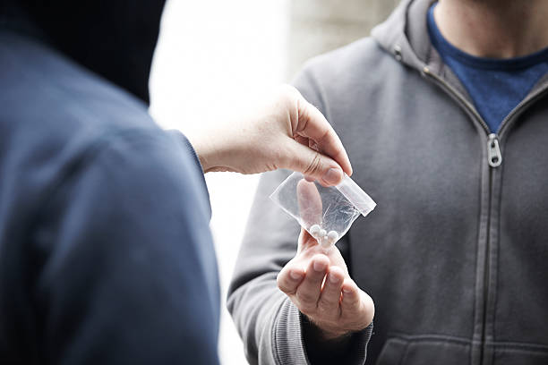
Bad Drugs
(Animal Models of Addiction)

Slide 2
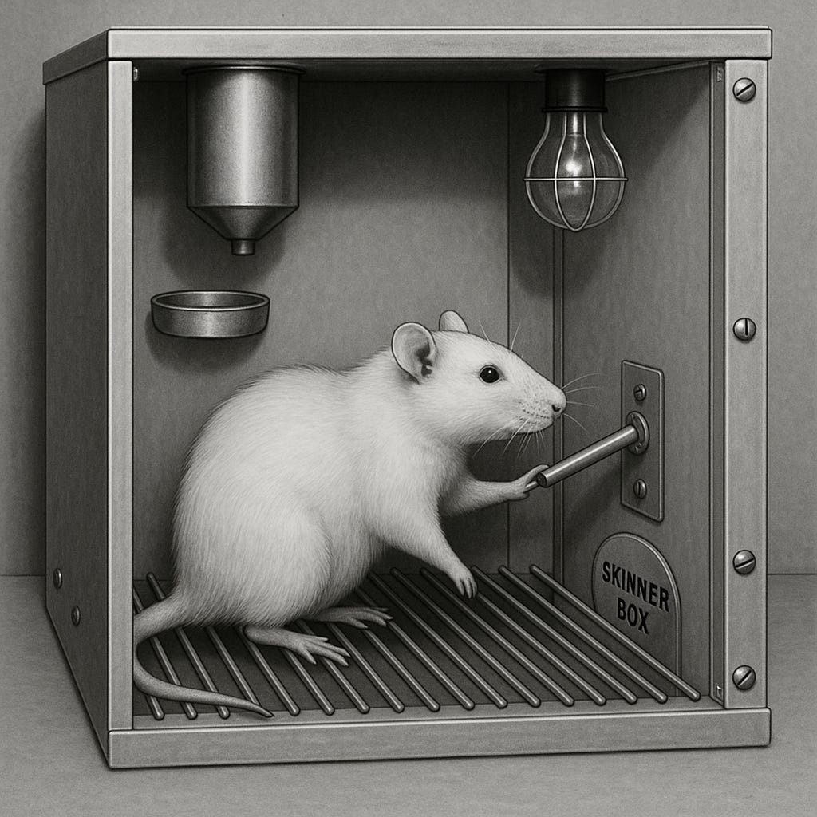
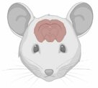

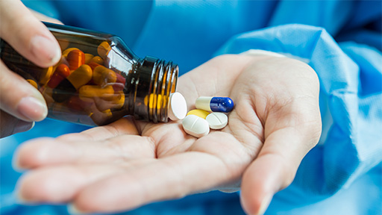
Why study drugs of addiction in animal models?
Explore the effects of drugs of abuse on the brain
Study drug-seeking behaviour
Test efficacy of potential treatments
Understand genetic risk-factors

Slide 3
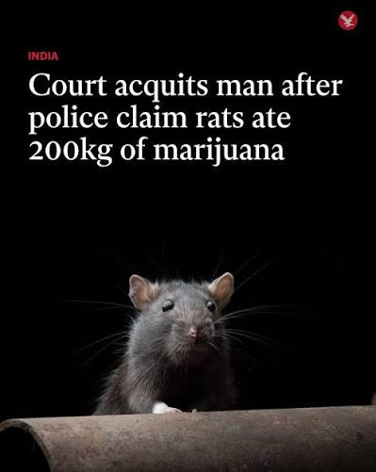
Step 1: Get your rat hooked on drugs
Not as easy as it looks!
Approach depends on the drug

Slide 4
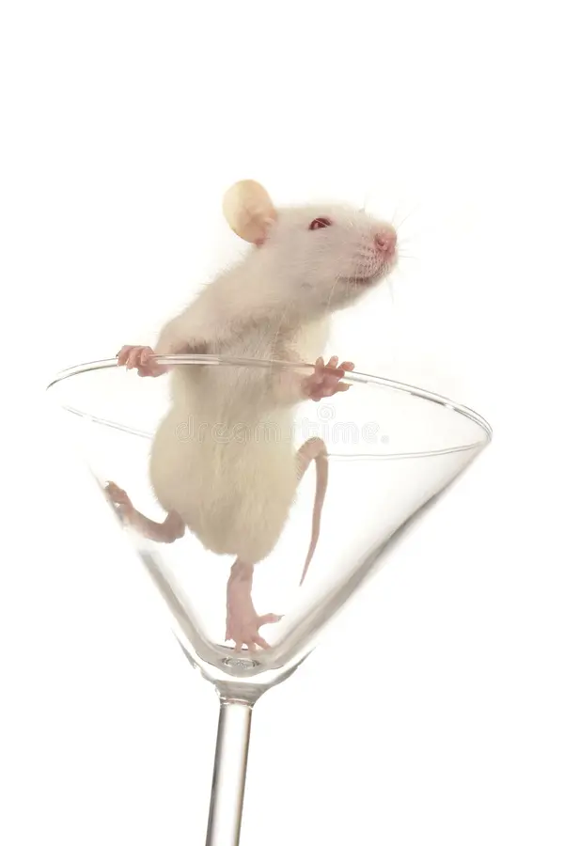
Alcohol
Problem: Rats don’t love the taste of ethanol. They need to be convinced to drink.

Slide 5
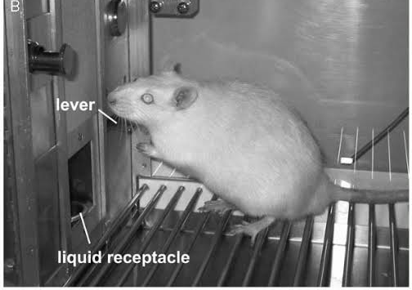
Option 1: Sucrose Fading
10% sucrose
8% sucrose
2% Ethanol
6% sucrose
4% Ethanol
4% sucrose
6% Ethanol
0% sucrose
8% Ethanol
2-3 Weeks of Training

Slide 6
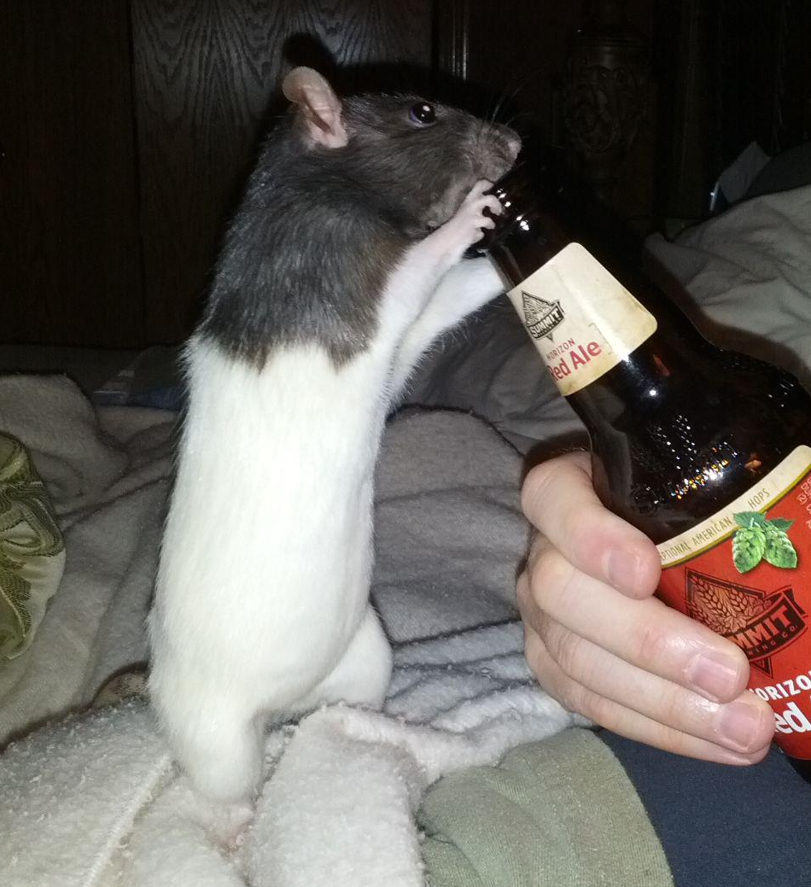
Option 2: Give ‘em Beer
Advantage: Rats will willingly drink (decarbonated) beer without training
Disadvantage: Harder to get them drunk (4% instead of 10%)

Slide 7
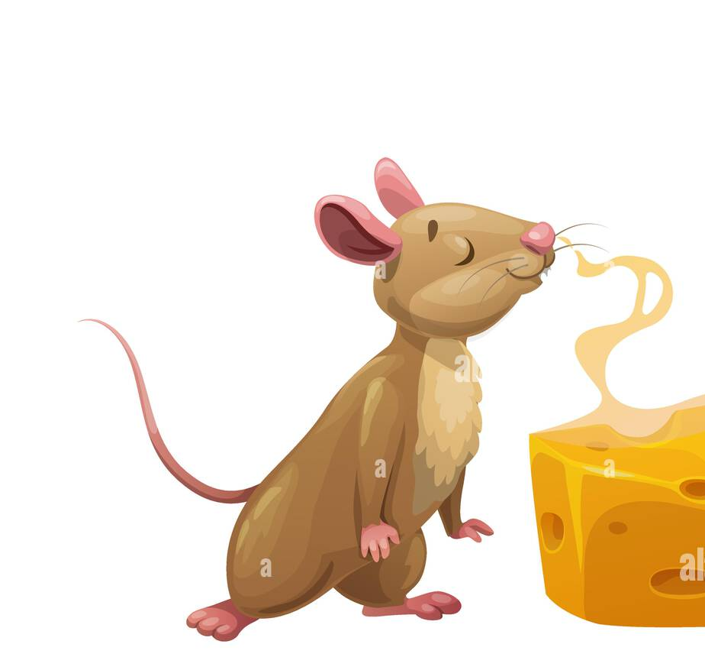
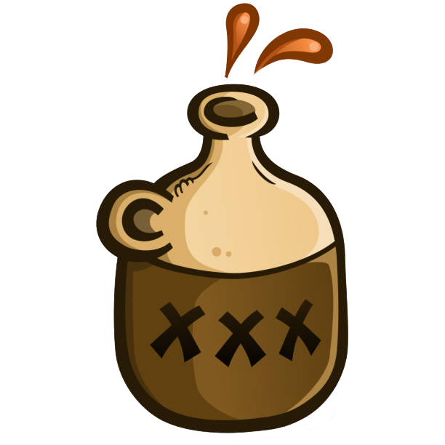
Option 3: Ethanol Vapour
Advantages
Experimenter can control dosage/timing
Model can be used to create ethanol-dependence
Disadvantages
Not “naturalistic”
Involuntary consumption may be stressful for animals

Slide 8
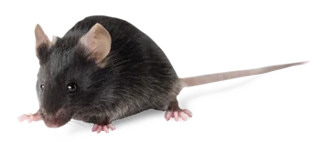
Option 4: Ethanol-Preferring Mice
C57/BL6J mice will happily drink ethanol (even up to 30%), sans mixers
Used to study binge-drinking behaviour

Slide 9

Drinking in the Dark: A model of binge-drinking
Mice given access to bottle with 20% ethanol for 2-4h/day
Delivery occurs ~3h into the “dark cycle” (i.e., when the lights are turned off for the night)
  Mice are nocturnal, so this is when natural ingestion behaviours are highest
-Thiel and Navarro, 2015

Slide 10
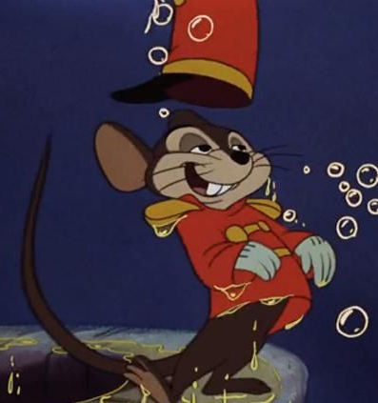
Drinking in the Dark: A model of binge-drinking
Mice will drink enough to achieve blood ethanol contents (BECs) >100mg/dL
  Binge = pattern of drinking resulting in BECs >80mg/dL
The behaviour causes physical signs of intoxication
-Thiel and Navarro, 2015

Slide 11
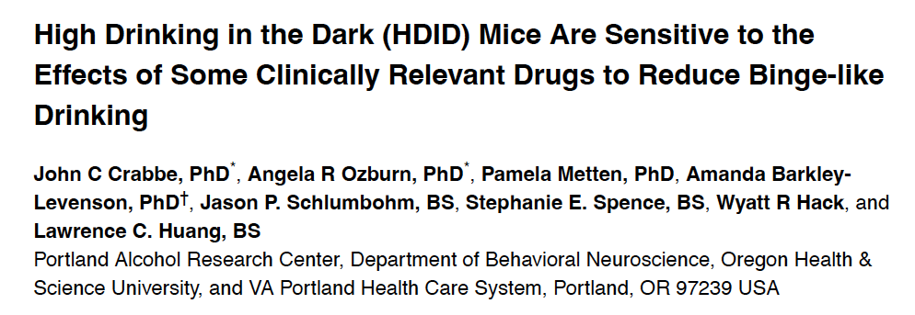
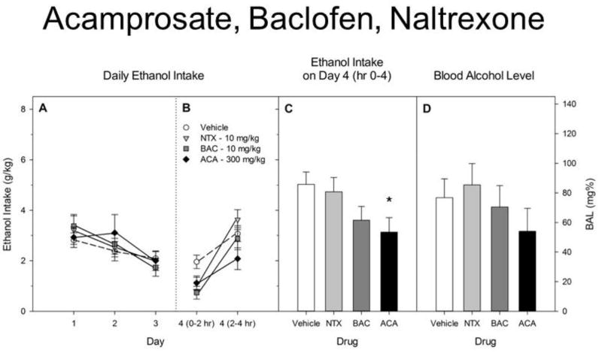
Uses of Model: Validating Treatments

Slide 12
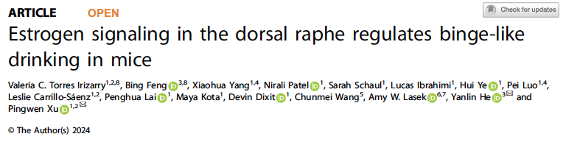
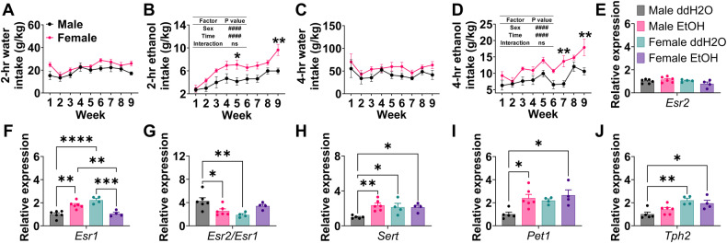
Uses of Model: Exploring Mechanisms

Slide 13
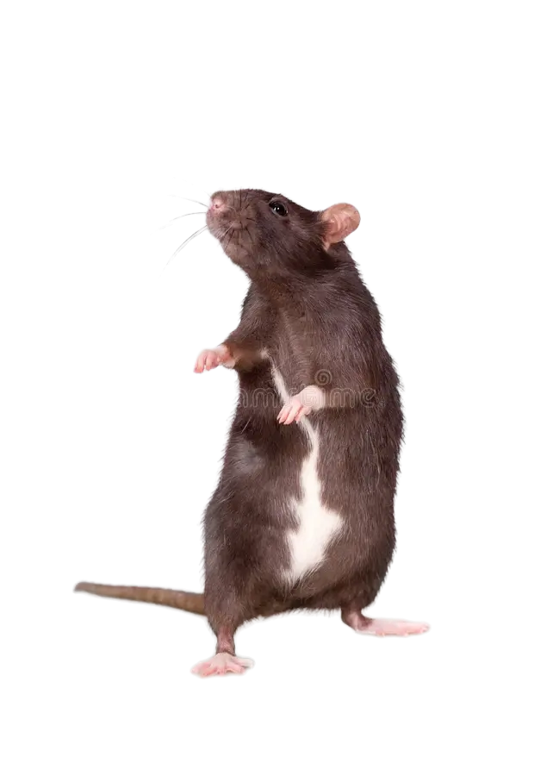
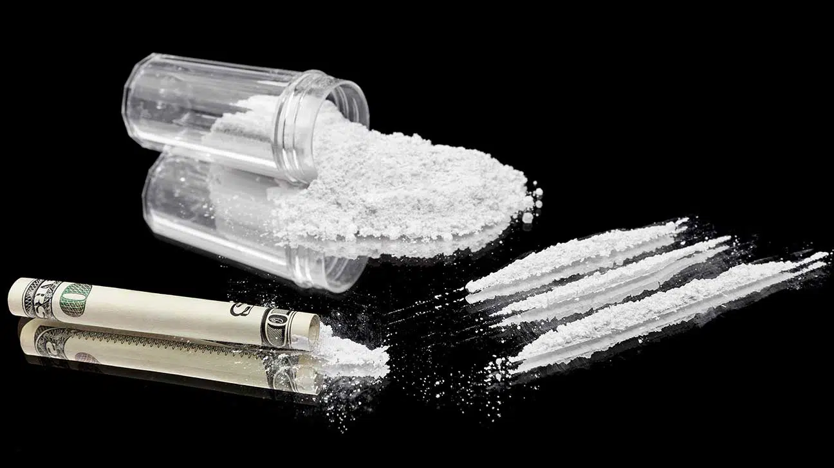
Stimulants

Slide 14
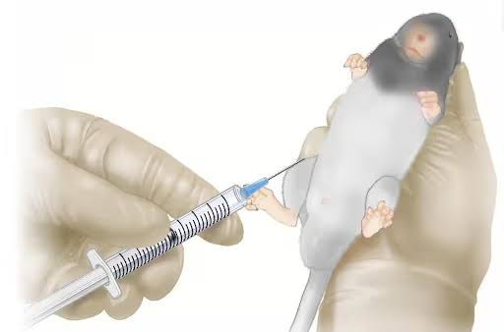
Option 1: Experimenter-Administered
Experimenter gives animal a single intraperitoneal (i.p.) injection of the drug
Okay for one-off or short-term experiments, but not feasible for most addiction research

Slide 15
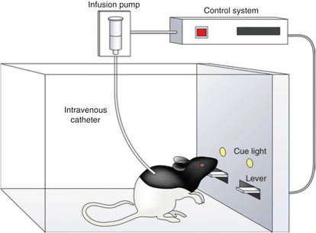
Option 2: Intravenous Self-Administration (IVSA)
Gold-standard for addiction research
Indwelling catheter implanted into jugular vein
Catheter can be attached to an infusion pump that delivers the drug directly to the bloodstream

Slide 16
Animal models of drug-seeking behaviour
Schedules of reinforcement for IVSA
Fixed Ratio
  One reinforcer every n responses (e.g., FR3 = 3 lever presses for one injection of drug
  Used during training to establish lever-pressing behaviour
Progressive Ratio
  Number of presses required for a reinforcement increases after each injection
    1st injection – 2 presses
    2nd injection – 4 presses
    3rd injection – 6 presses
    4th injection – 9 presses
    etc

Slide 17
Animal models of drug-seeking behaviour
Schedules of reinforcement for IVSA
Fixed Ratio
  One reinforcer every n responses (e.g., FR3 = 3 lever presses for one injection of drug
  Used during training to establish lever-pressing behaviour
Progressive Ratio
  Number of presses required for a reinforcement increases after each injection
  Breakpoint
    The number of presses at which the animal “gives up” and goes a certain amount of time without pressing the lever
    Corresponds to number of presses they completed to receive their last injection (e.g., if last injection took 162 presses, the breakpoint is 162)

Slide 18
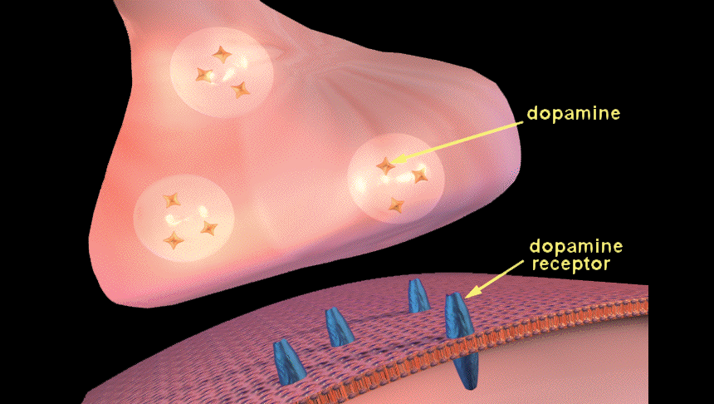
Testing Potential Treatments using IVSA and Progressive Ratio Breakpoints
Background
Cocaine is a dopamine “agonist” (i.e., increases dopamine activity in the brain)
There are 5 subtypes of dopamine receptor in the brain (D1-D5). They are expressed in different areas and do different things when dopamine binds to them.
Some drugs selectively block activity at specific dopamine receptor subtypes
  Haloperidol (mostly blocks D2)
  SB-277011A (blocks D3)
Xi et al., 2013

Slide 19
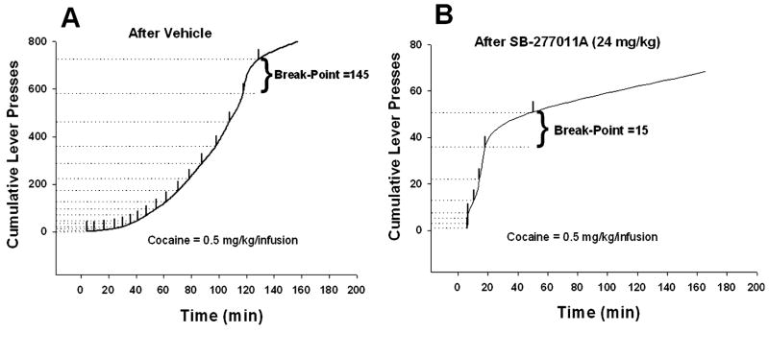
Testing Potential Treatments using IVSA and Progressive Ratio Breakpoints
Pre-treatment with the D3 antagonist decreased motivation to work for cocaine (i.e., dramatically lowered the breakpoint).
Xi et al., 2013

Slide 20
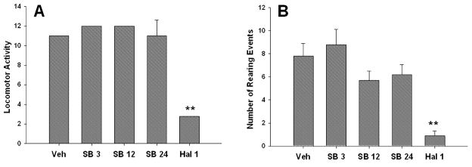
Testing Potential Treatments using IVSA and Progressive Ratio Breakpoints
Pre-treatment with the D3 antagonist had no impact on locomotor activity.
Locomotor activity was significantly reduced with the D2 antagonist.
Xi et al., 2013

Slide 21
But what about sex??
Impacts of alcohol and stimulants on male sexual behaviour/decision-making

Slide 22
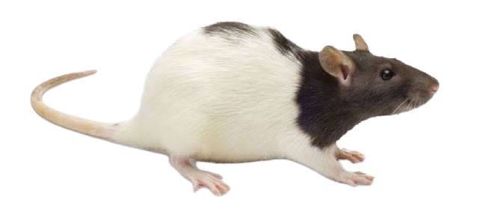

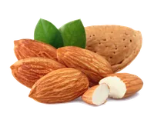
Training
YES!
Nope.
Test
YES!
YES!

Slide 23
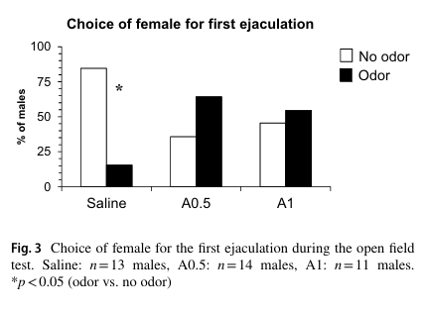
Impacts of alcohol on learned sexual inhibition
Germe and Pfaus, 2024

Slide 24
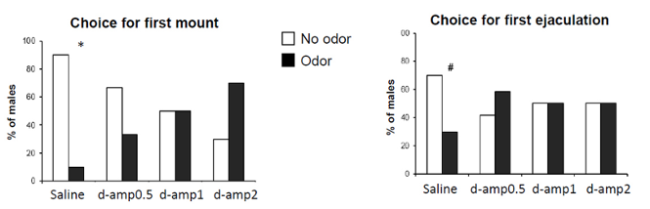
Impacts of amphetamine on learned sexual inhibition
Germe et al., 2025

